Slide 1
Ingress-Nginx – Istio Migration
- Soumya Prakash Barik

Slide 2
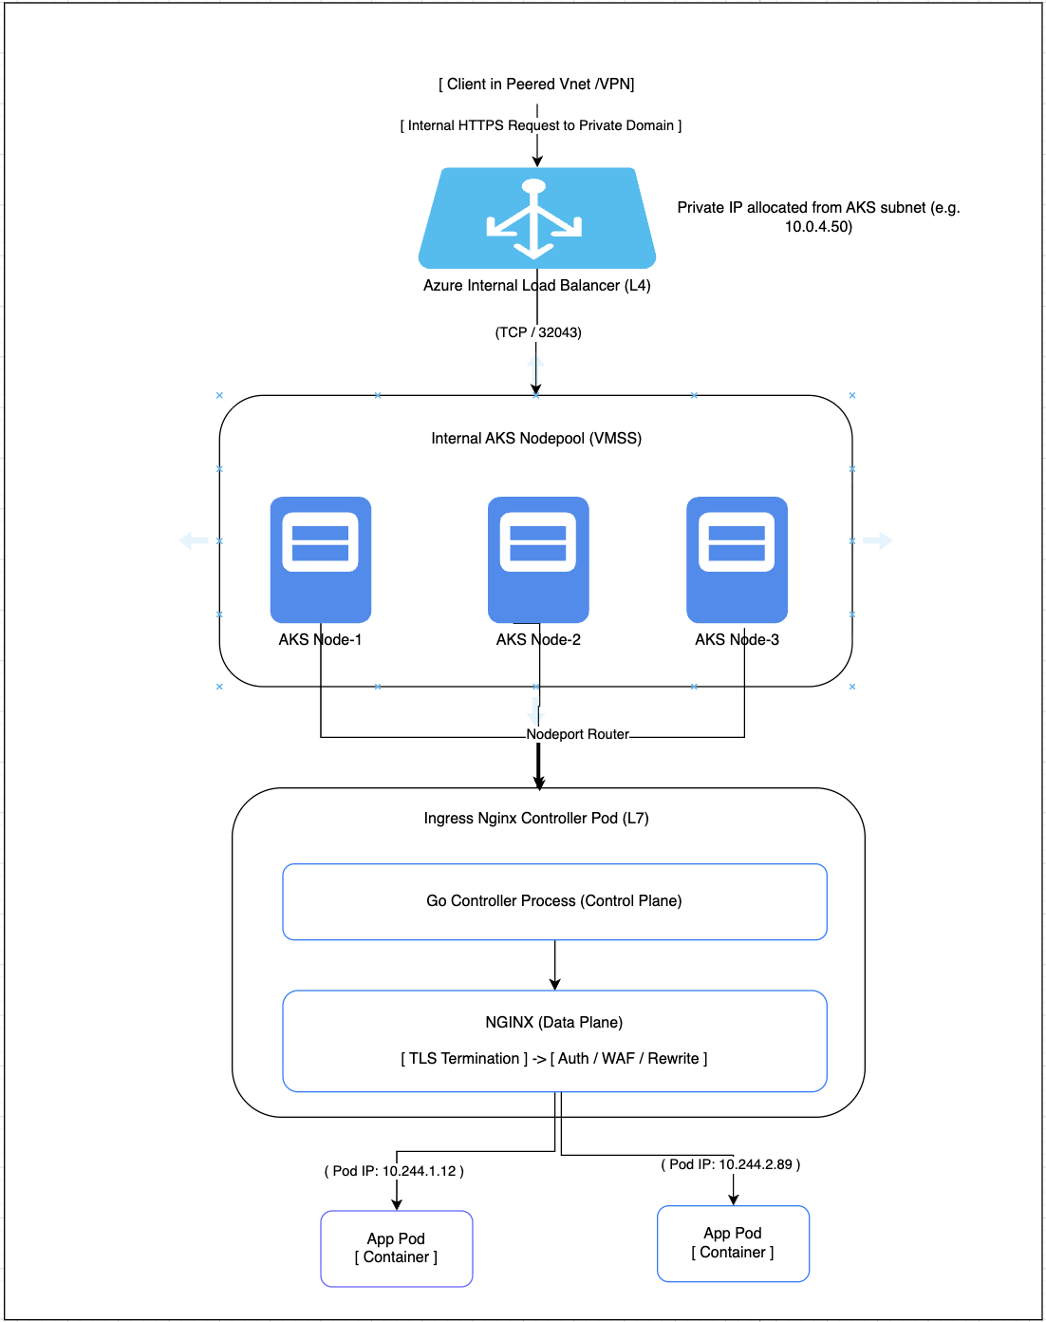
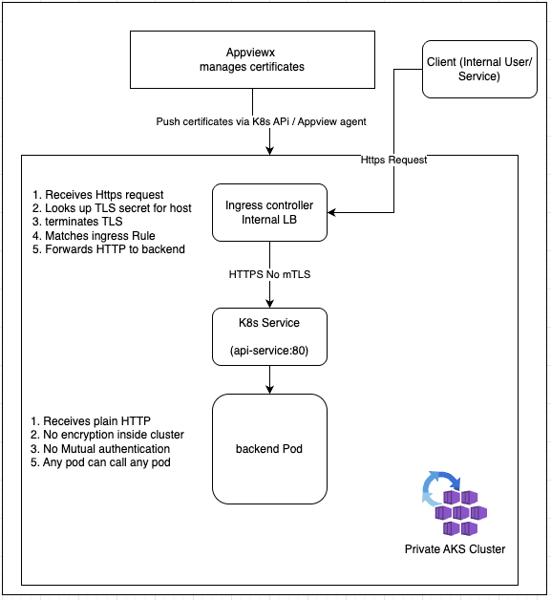

Existing Ingress-nginx setup

Slide 3
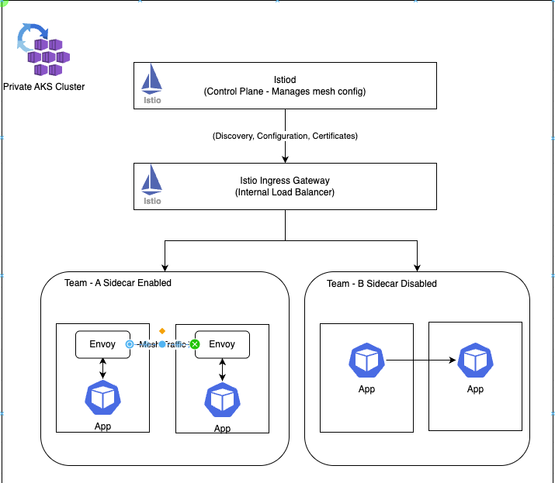
Istio with Private only AKS
Key Features:
Internal Loadbalancer : No public exposure
Selective injection: Per namespace or per pod
mTLS Optional: Based on team needs
Latency Trade-off: +2-5ms with sidecar

Slide 4
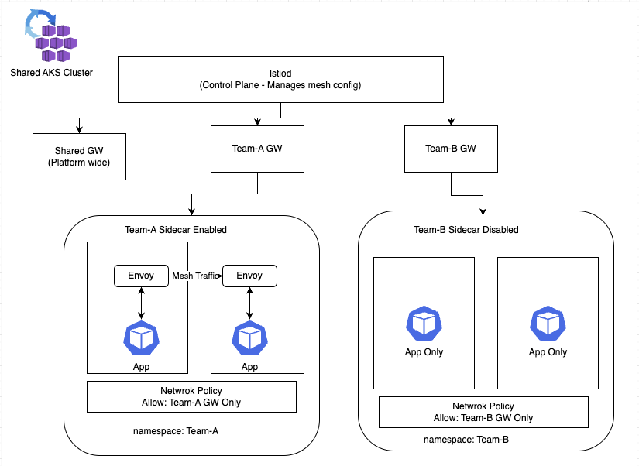
Istio with Shared AKS multi-cluster
Multi-Tenancy Features
Per-Team Gateways: Each team manages own ingress
Namespace Isolation: Network Polcy + Autherization policy
Flexible sidecars: Team chose injection strategy
Shared control Plane: Single Istiod, Lowed Overhead
Istio Resource Overhead
Component | CPU | Memory
Istiod (Per cluster) | 500m-1core | 512mb-1gb
Ingress GW | 200m-1core | 256mb-1gb
Egress GW | 100m-500m | 128m—512mb
Sidecar (Per pod) | 50m-500m | 64mb-256mb

Slide 5
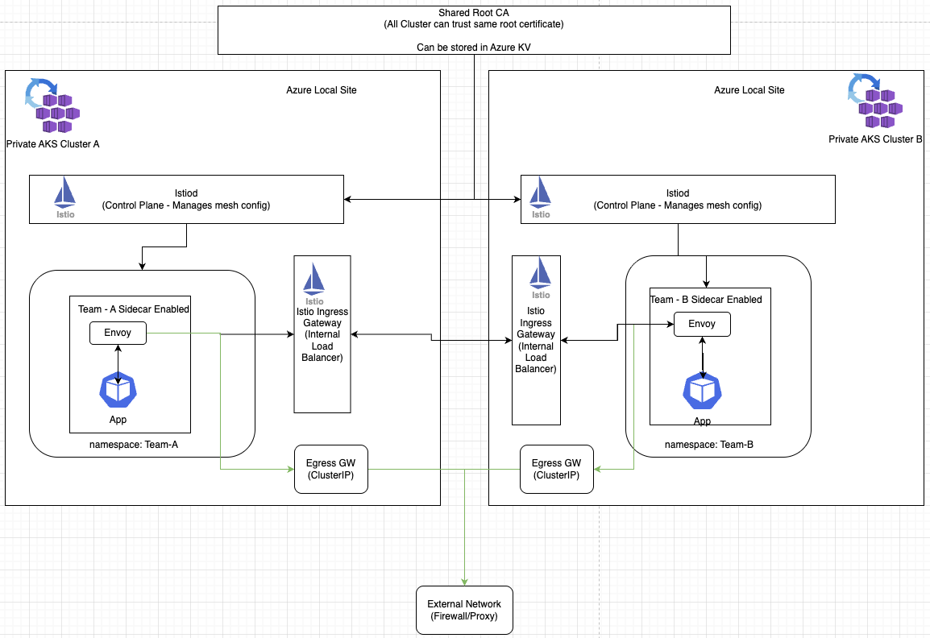
Istio with Azure Local
Egress Control Benefits
Whitelist external hosts
Audit all outbound traffic
Prevent data exfiltration
Compliance enforcement

Slide 6
Istio Governance Model
Component | Self-Managed | AKS Add-On
Istio Installation/Upgrades | Platform Team | Azure
Istiod (Control Plane) | Platform Team | Azure
Istiod Scaling/HA | Platform Team | Azure
Istiod Configuration | Platform Team | Shared (Limited)
Sidecar Injection | Platform Team | Azure
Istio CRDs | Platform Team | Azure
Istio Version Selection | Platform Team | Azure
Ingress GW | Platform Team | Azure
Ingress GW config | Platform Team | Platform Team
Egress GW | Platform Team | Azure
Root CA | Platform Team | Azure
Intermediate CA | Platform Team | Azure
Workload Certificates | Automatic | Azure (Automatic)
Mesh wide mTLS | Platform Team | Platform Team
PeerAuthentication & Service Entry | Platform Team | Platform Team
AuthorizationPolicy | Platform/App Team | Platform/App Team
VirtualService | App Team | App Team
DestinationRule & Sidecar (resource) | App Team | App Team

